Slide 1
XML for Android
Joesph Olliff

Slide 2
Topics
What is XML?
How XML works
The role that XML plays in Android Development
Tools you should be aware of.

Slide 3
What is XML?
eXtensible Markup Language
Similar to HTML in that it performs no logic
Used to store static resources in an organized manner that is independent of any application that may access the information

Slide 4
Advantages of XML
Platform Independent
Transports data and their relationships

Slide 5
How does XML work?
XML only has a handful of requirements to its layout. This is both a strength and a weakness
All XML files must begin with <?xml version=“1.0” encoding=“utf-8”?>
The XML document is a collection of Nodes that either contain further child nodes or some form of text
Remember the purpose of XML is store static resources in a well organized manner for other applications to use.

Slide 6
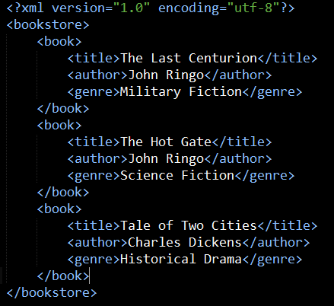
Example XML Document

Slide 7
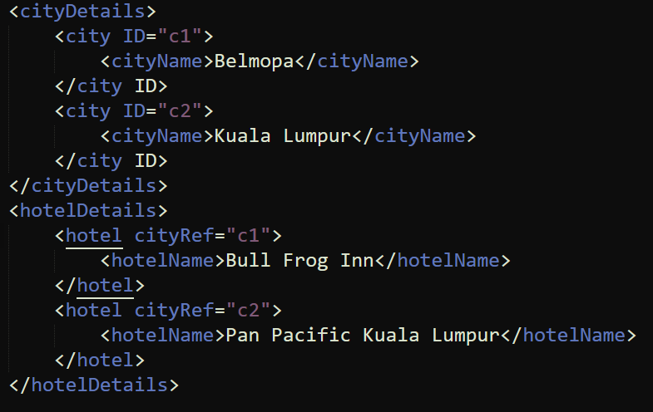
Example XML Document with Attributes

Slide 8
A Note About XML Schemas
XML Schemas (XSD) are a set of rules to describe the elements in an XML document
World Wide Web Consortium (W3C) provides some XSDs and links to include the Schema in your XML Document

Slide 9
How is XML used by Android
Store Application settings
AndroidManifest.xml contains your heading information that identifies your application and what libraries it needs to the Android OS.
To determine the layout and appearance of your User Interfaces (Activities)
Storage for any static resources, i.e. Help messages, notification text, etc..

Slide 10
How is XML used by Android
Describing Views!

Slide 11
Tools for XML
There are several classes within the Xamarin library for working with XML files
One potential tool is the XmlDataDocument class in the System.Xml library
This loads the entire XML Document into a relational data structure
Every major language has its own libraries or tools for reading and editing XML documents.

